Slide 1


MULTIMODAL CHATBOT
Machine Learning Project
SRM University - AP

Slide 2

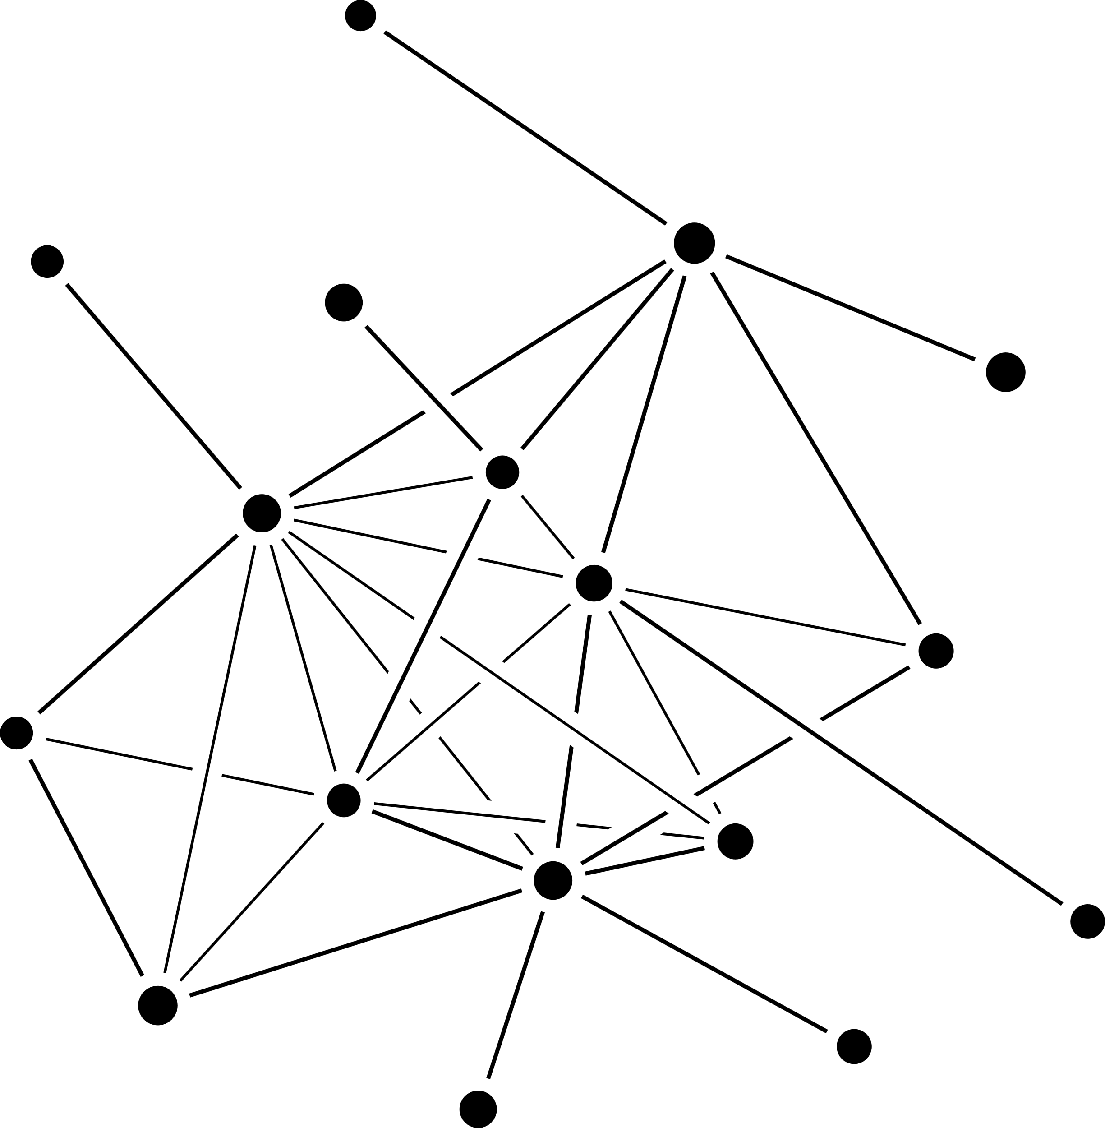
01
02
Introduction
Literature Study
Table Of Contents
03
04
End-to-End memory networks
Proposed Architechture
05
06
Future Work
References

Slide 3








INTRODUCTION
● A multimodal chatbot is a type of artificial intelligence (AI) that is capable of recognizing and responding to multiple modes of input.
● Chatbots can be used in the customer service and Applications
● Users can communicate with a virtual assistant by using chatbots, which enables quicker and more precise responses.

Slide 4


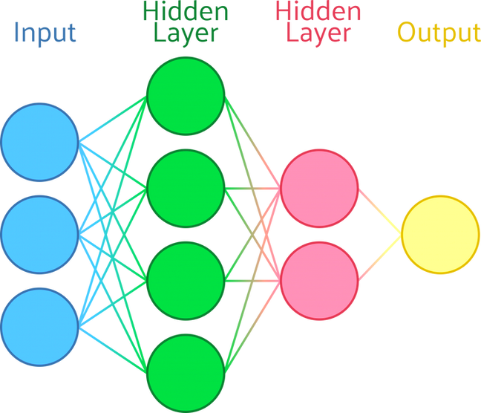
LITERATURE STUDY
MEMORY NETWORKS:
● A memory network is a type of artificial neural network that uses dynamic memory to store and recall data.
● It is based on the idea of making a computer system that can learn and store information like a human brain.
● Memory networks are trained using a type of supervised learning called the long short-term memory (LSTM) architecture.

Slide 5
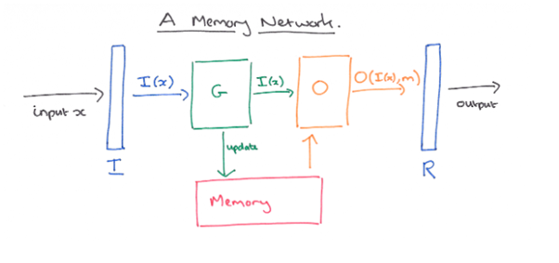

Slide 6


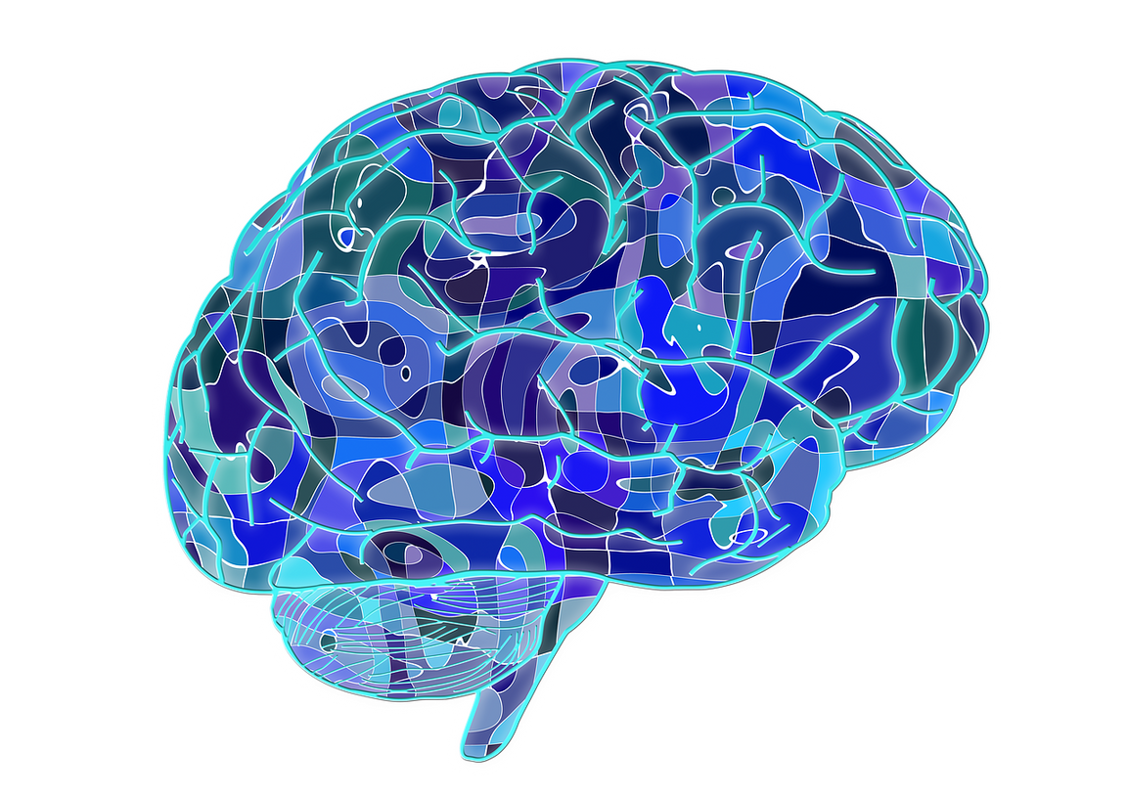


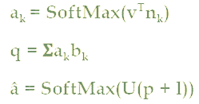

END-TO-END MEMORY NETWORKS
● An end-to-end memory network is a neural network architecture that can be used to learn and remember information over extended periods of time.
● The network consists of a memory component, which stores information in a vector space, and a neural network that learns to read and write to the memory
● The network can be trained to perform a variety of tasks, such as read comprehension, question answering, and language translation.

Slide 7

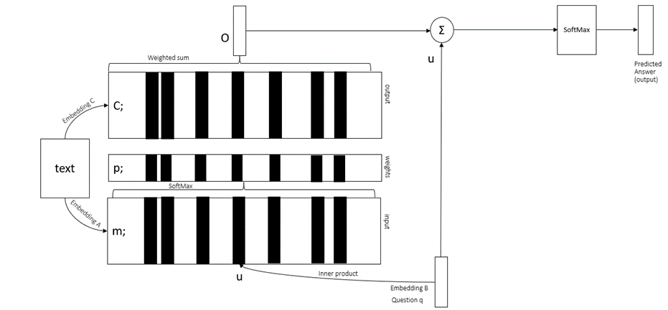


Slide 8
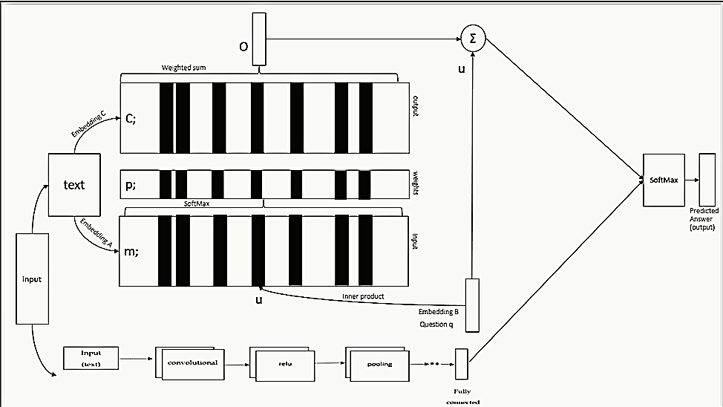
PROPOSED ARCHITECTURE

Slide 9

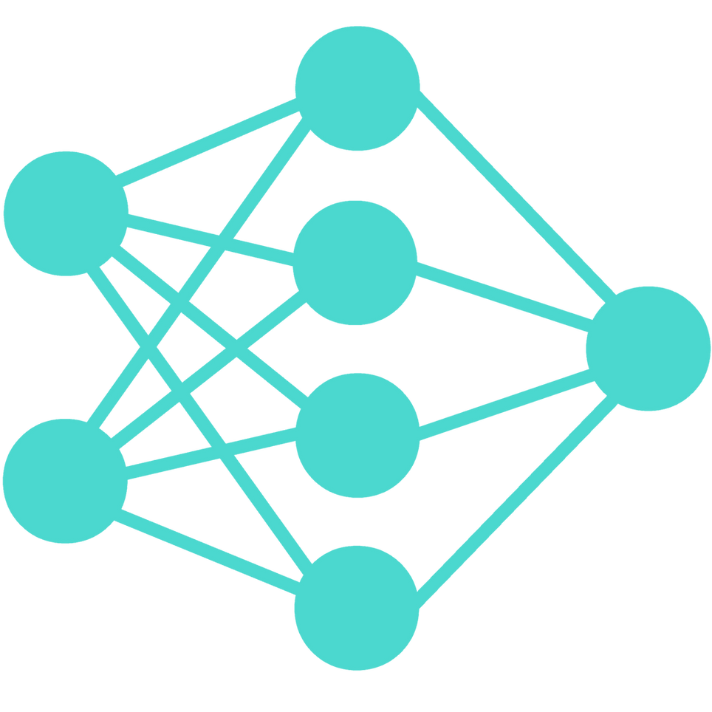
CONVOLUTIONAL NEURAL NETWORKS
Convolutional neural networks perform better than other neural networks because they can input speech, audio, or visual data. CNN is used to solve computer vision issues including image recognition and classification. The way a computer perceives an image is as an array of Pixel values. Computers see images as values between 0 and 255, where 0 to 255 represents the current pixel intensity. In the CNN, there are 4 levels ,which are:
● Convolutional layer
● Relu Layer
● Pooling layer
● Fully-Connected layer

Slide 10
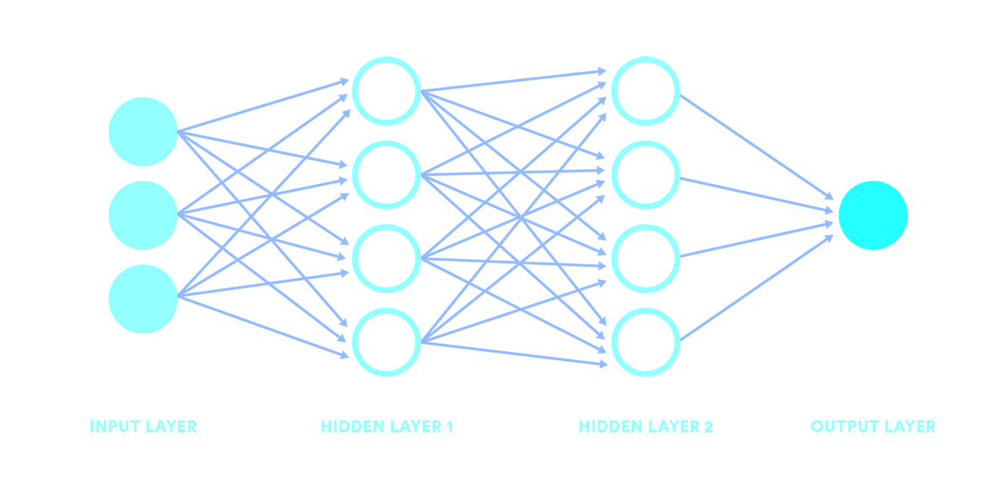
CONVOLUTIONAL LAYER
● Most of the calculations are done in this layer and it also serves as a basic part of CNN
● Applies a convolutional kernel to an input volume, producing an output volume.
● Can be used to implement edge detection, motion detection, and other types of image processing.
● The convolutional kernel is typically a small matrix of weights that is applied to the input volume element-wise. The output of a convolutional layer is typically a feature map, which is a three-dimensional array of values.

Slide 11
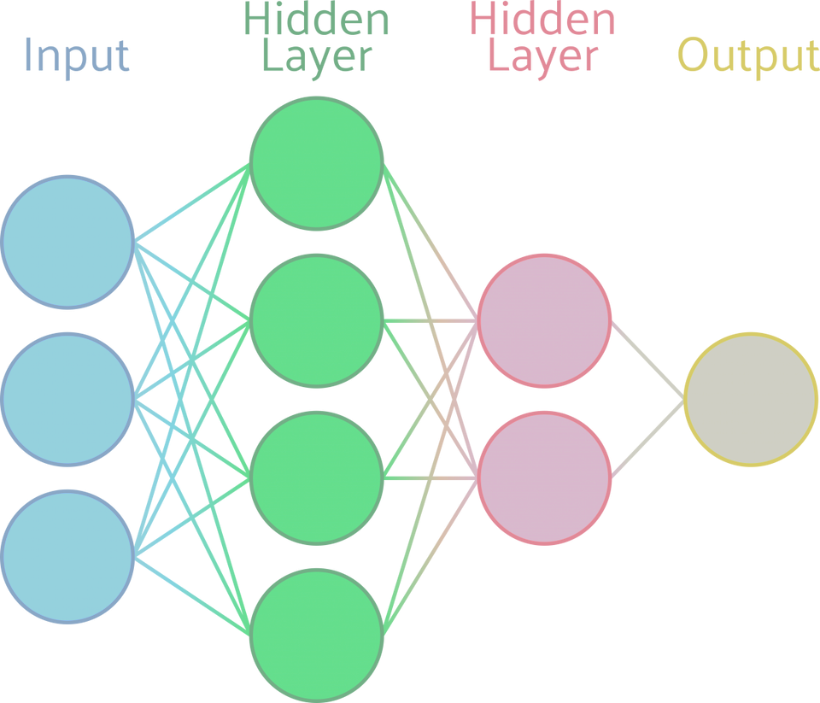
RELU LAYER
●The ReLU layer is a commonly used activation function for deep learning models, introducing nonlinearity into a neural network with an element-wise activation function that takes a single number as an input and produces another number as an output.

Slide 12
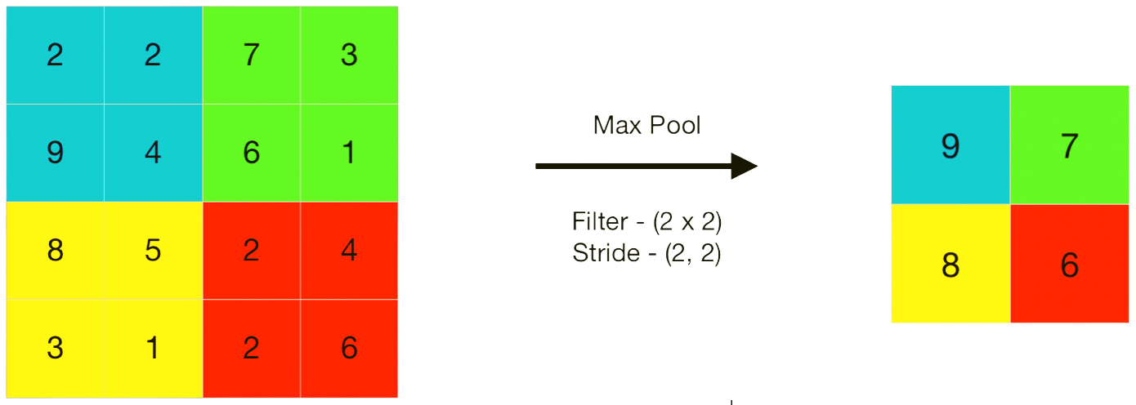
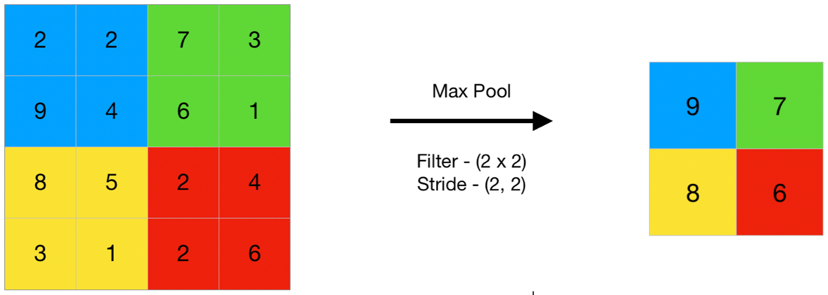
POOLING LAYER
● A pooling layer is a type of layer in a CNN which reduces the spatial size of the input representation by taking the maximum/average of values in a window.
● It helps to control overfitting and makes the network invariant to small transformations in the input image.
● Commonly used pooling functions are MAX and AVERAGE.

Slide 13
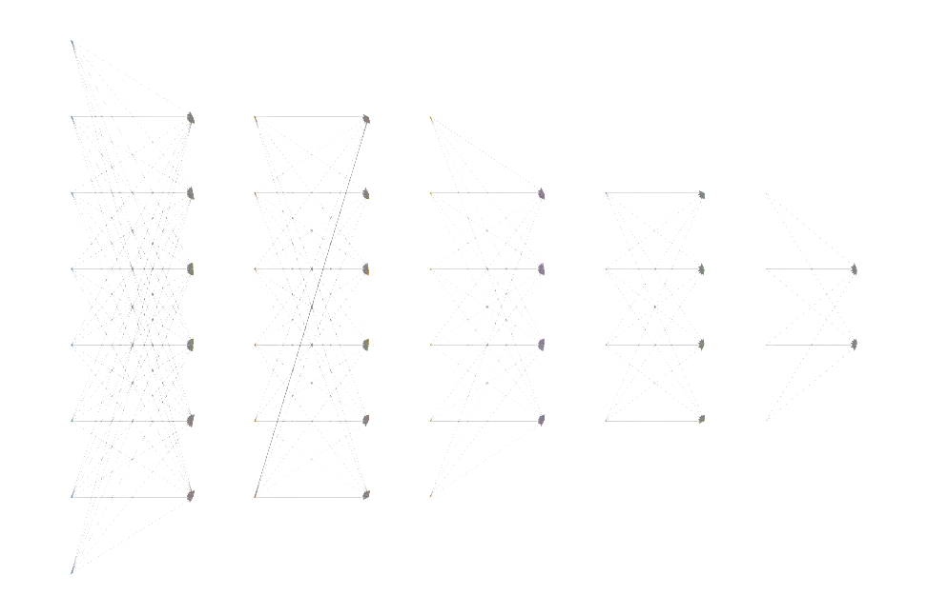
FULLY-CONNECTED LAYER
● A fully connected layer is a layer that lacks convolution or pooling operations.
● It is the last layer in the network where the outputs from the preceding layers are compressed before being attached to each neuron in the fully connected layer.
● During training, the weights for each neuron are modified to allow for accurate classification of the features extracted from convolutional layers.
●To make predictions, SoftMax activation functions are usually employed to generate probabilities ranging from 0 to 1

Slide 14

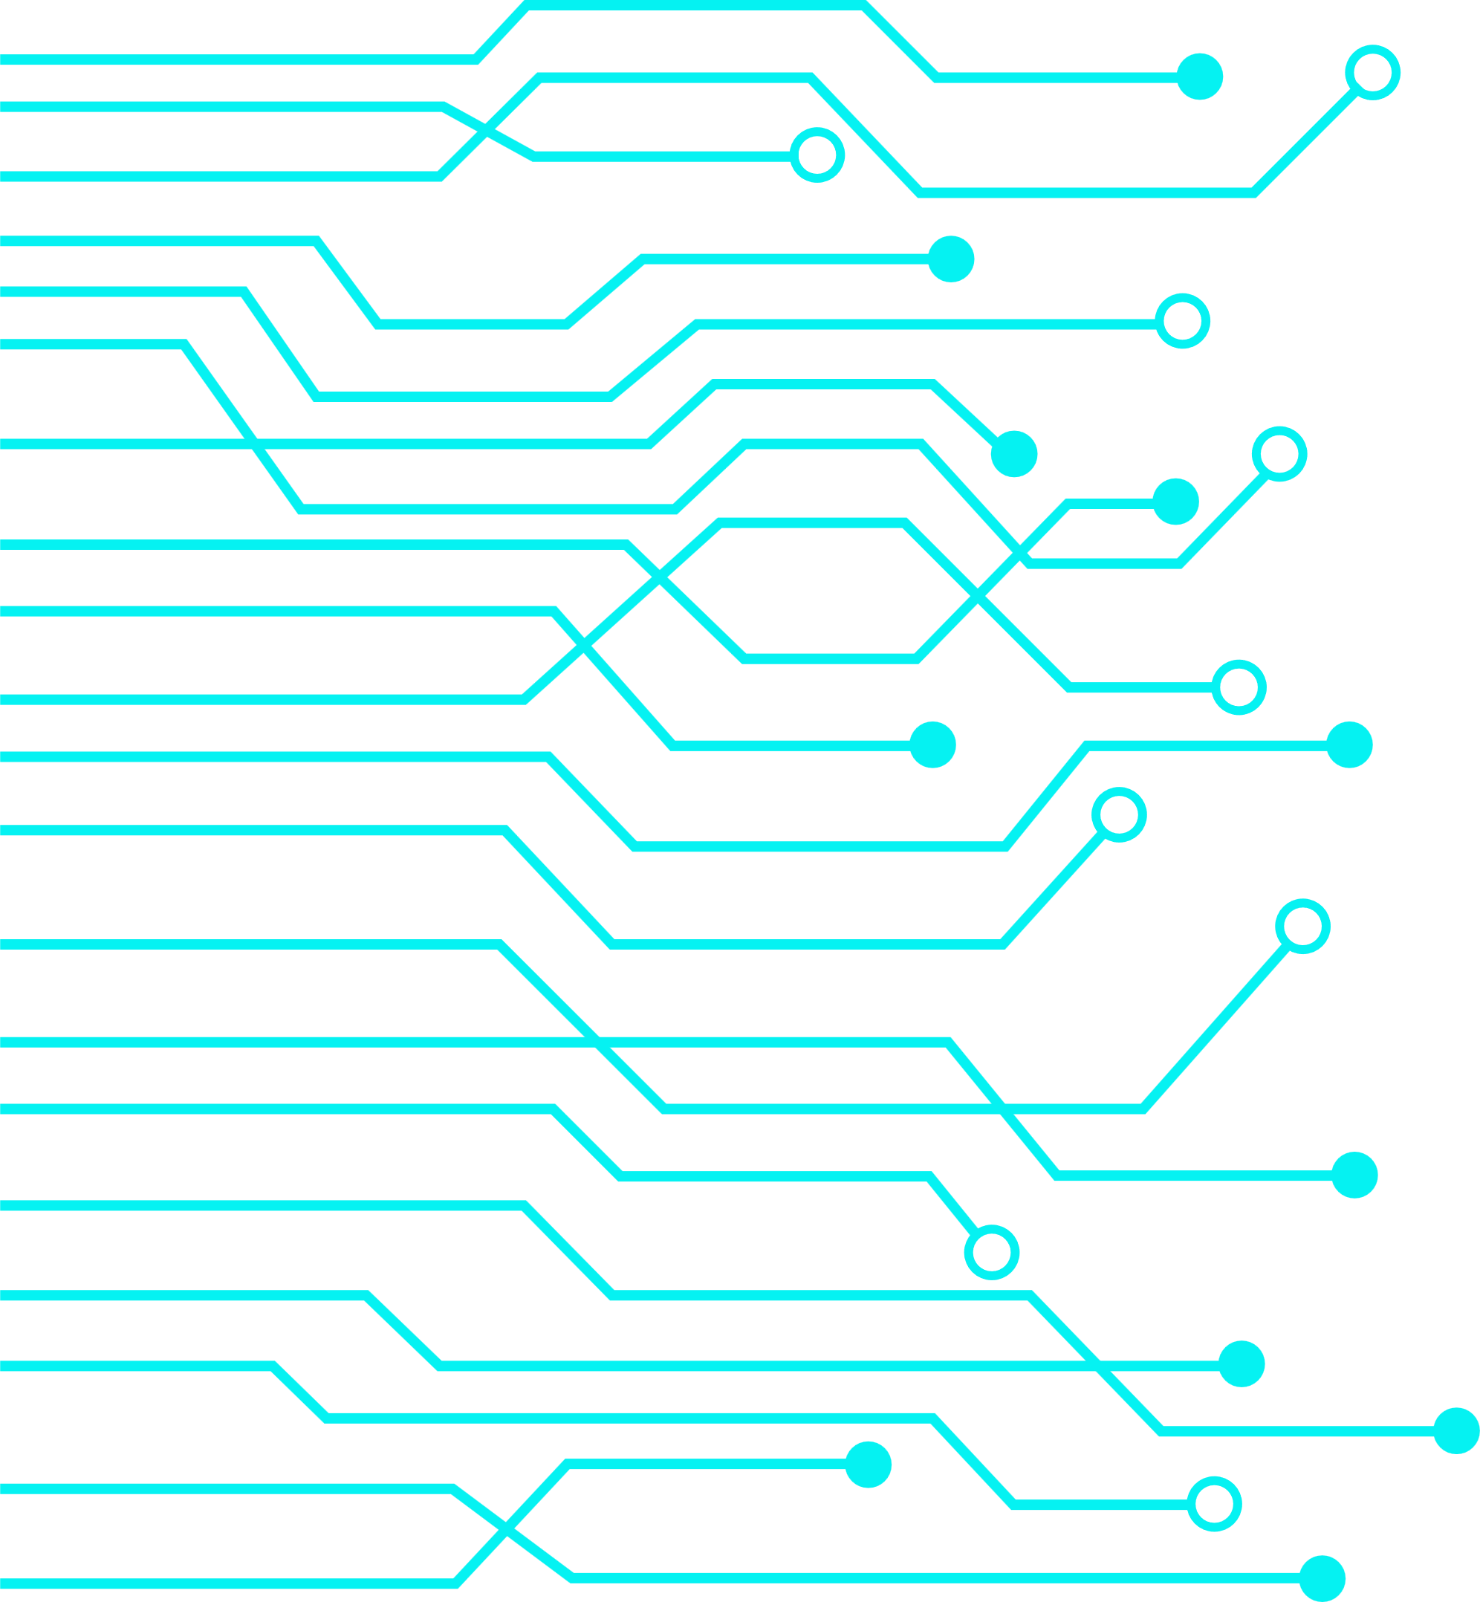
FUTURE WORK
Scope to develop project
We will develop a multi-modal chatbot which includes two modules one which used to detect the age and gender of the person other module includes a Covid19 chatbot which is used to detect weather the user is having covid19 or not by using the help of CT scans which are provided by the user. We are using some approaches like CNN, End to End MN to build a chatbot.. In order to enhance the analytical model by improving the data accuracy, That will assist the user in determining their likelihood of having COVID-19.

Slide 15

Thank You
Subhash – AP22110010068
Ganesh - AP22110010071
Harshitha - AP22110010096
Sajida - AP22110010098
Akhil - AP22110010102
Krishna Teja - AP22110010105

